Slide 1
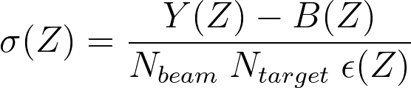
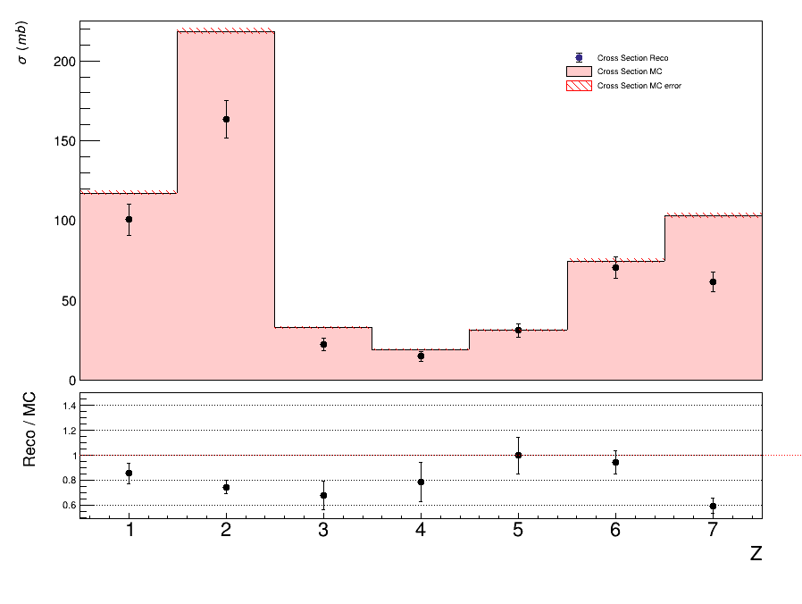
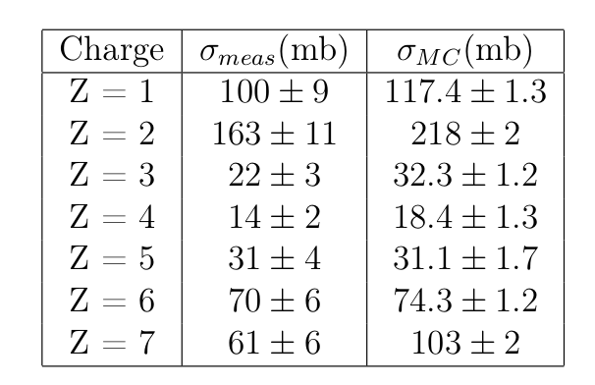
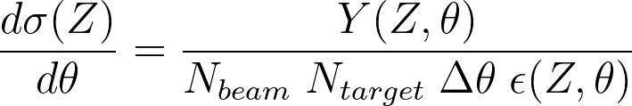
Experimental results - elemental cross section
Yield obtained from run 4306 taken in GSI 2021 campaign
Fiducial cross section (θ<2.5°) to limit overall noise
➔ high consistency
9
Giacomo Ubaldi

Slide 2
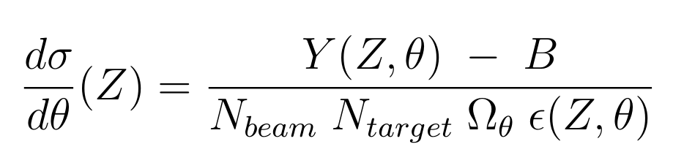
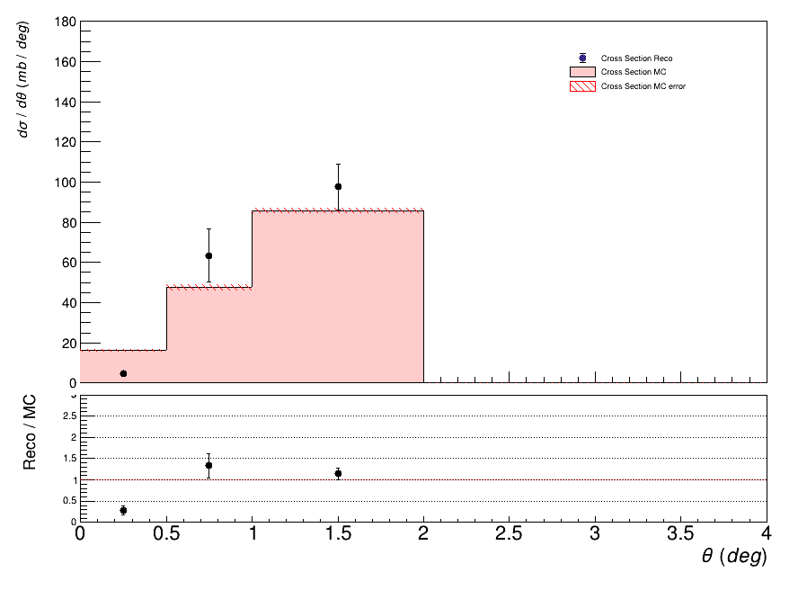
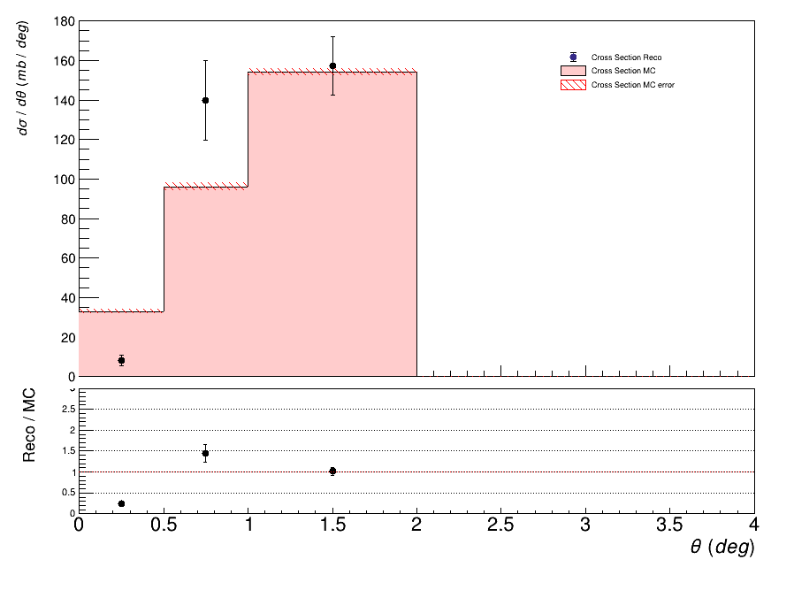
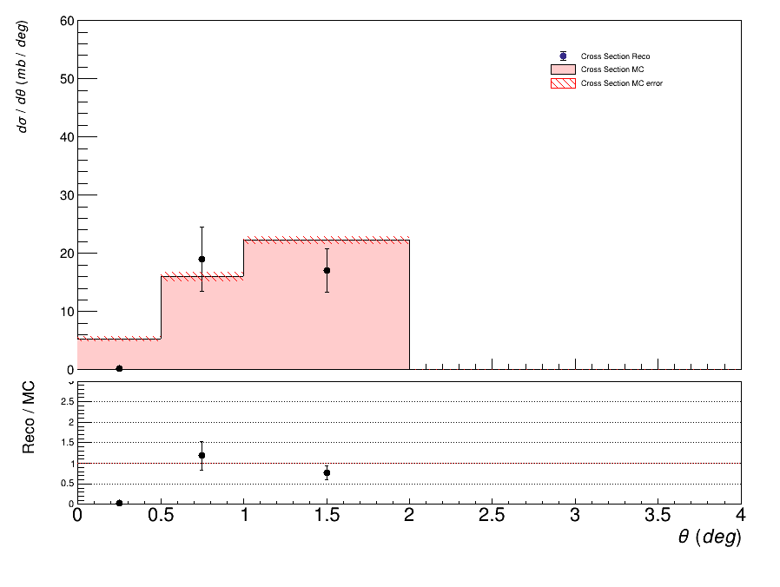
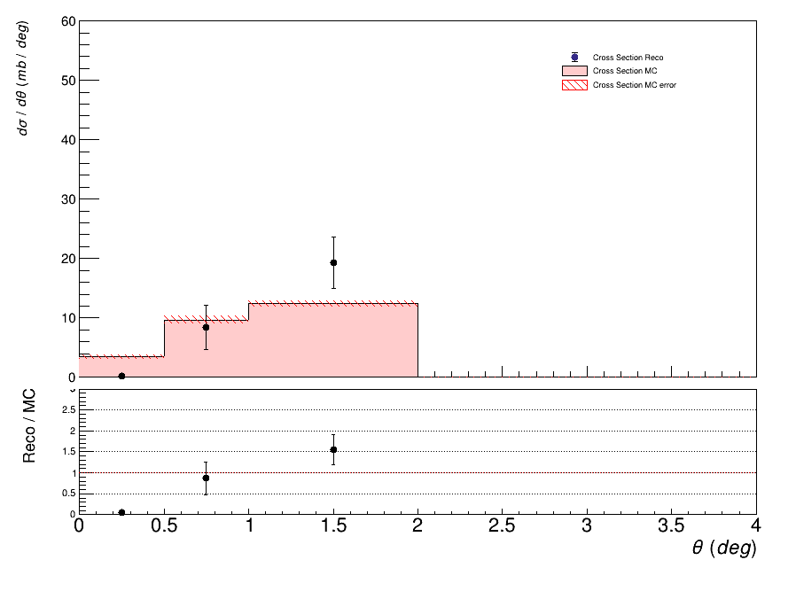
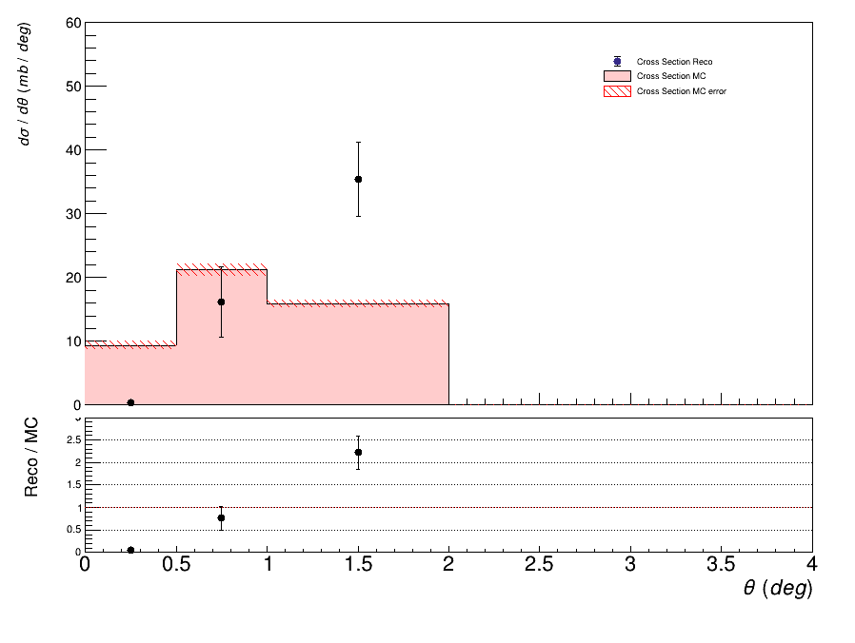
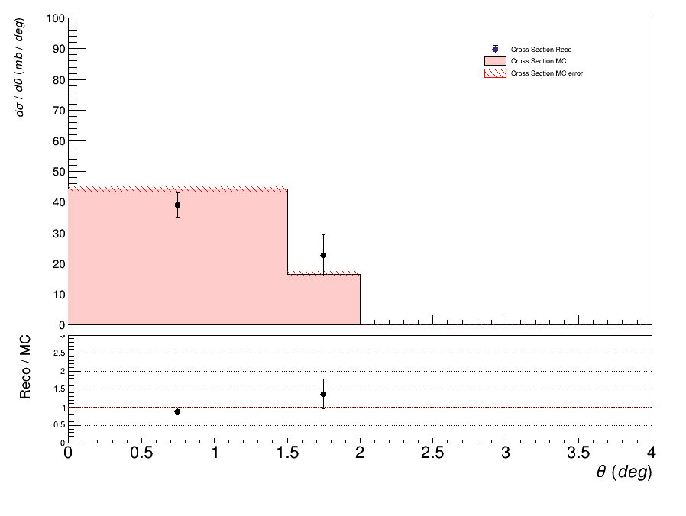
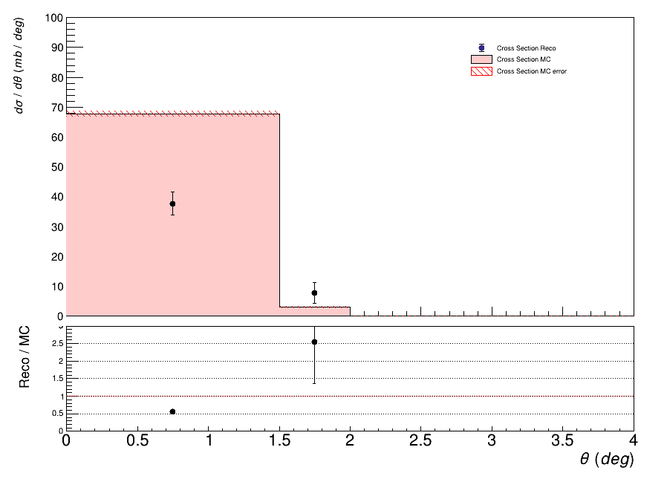
Experimental angular differential cross section
z=1
z=2
z=3
z=4
z=5
z=6
z=7

Slide 3
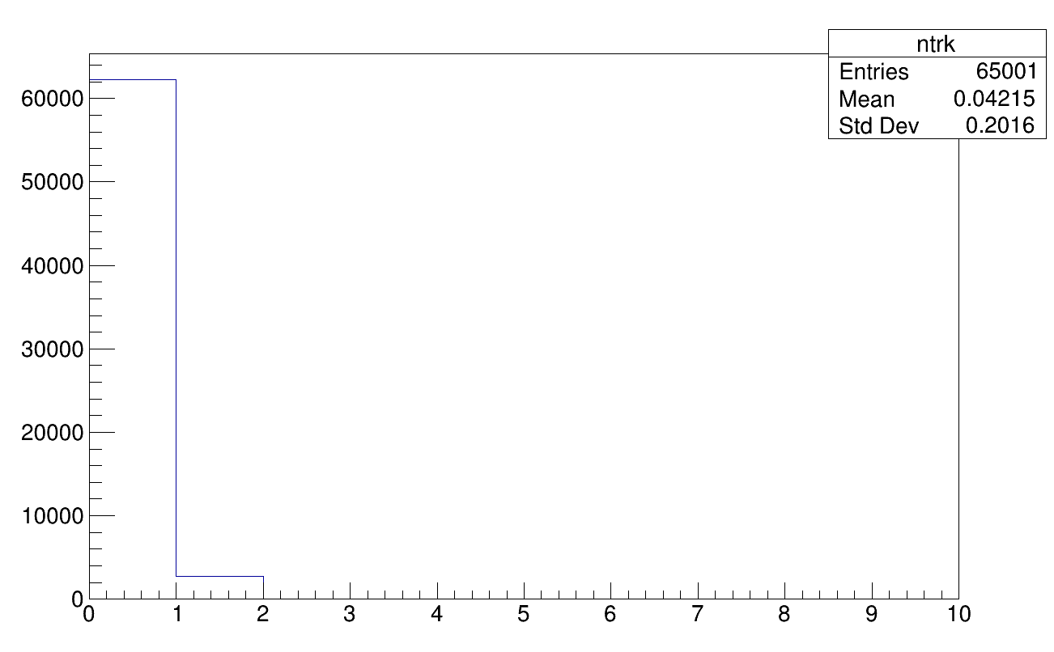
Experimental data issues
GLB tracking
4 points (VT) + 1 (TW)
High inefficiency in track
reconstruction
Is it a problem of VT?

Slide 4
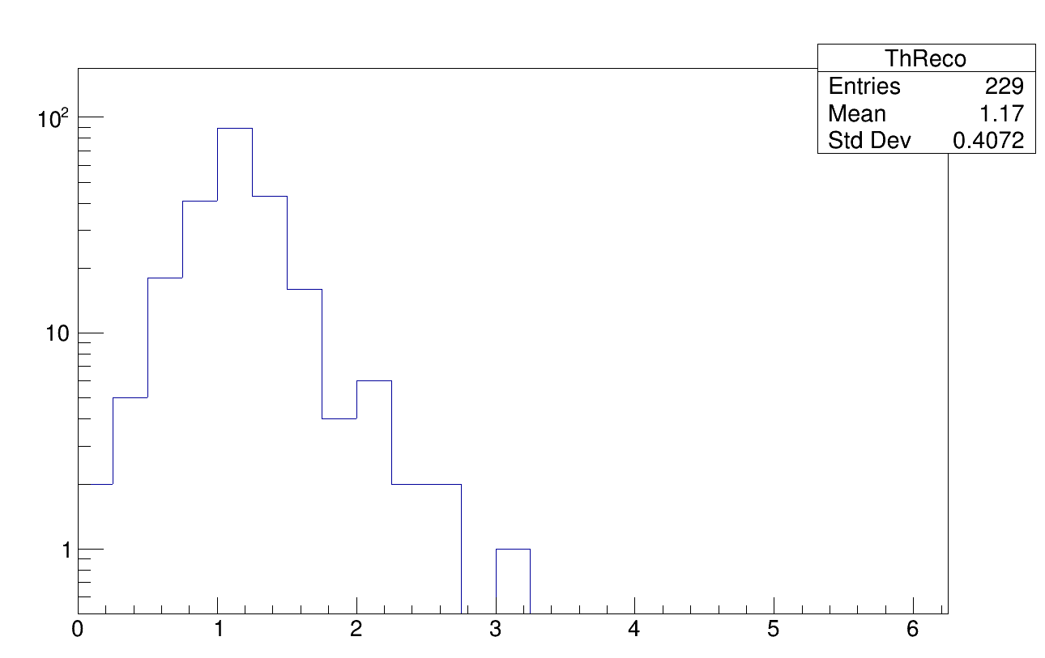
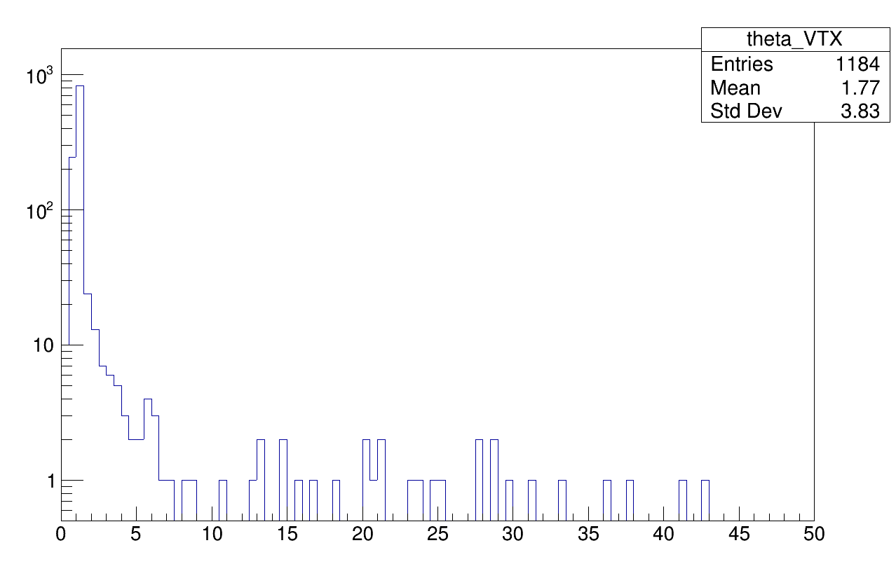
Global vs VT theta
Global theta
VT theta
It seems tracks with wider angle aperture than 2/3° are not reconstructed

Slide 5
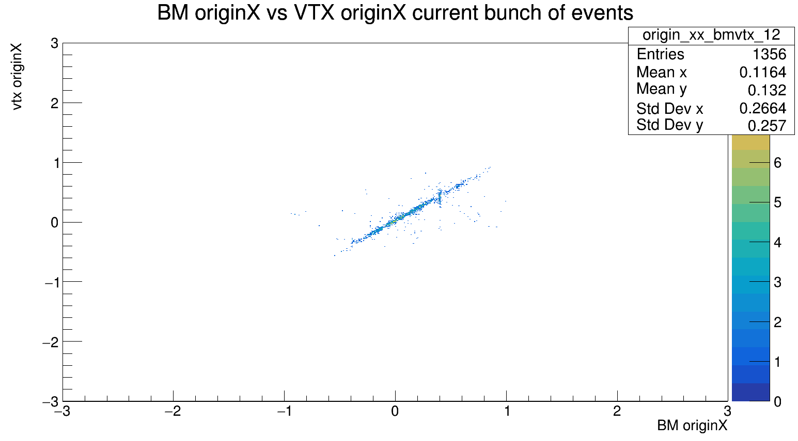
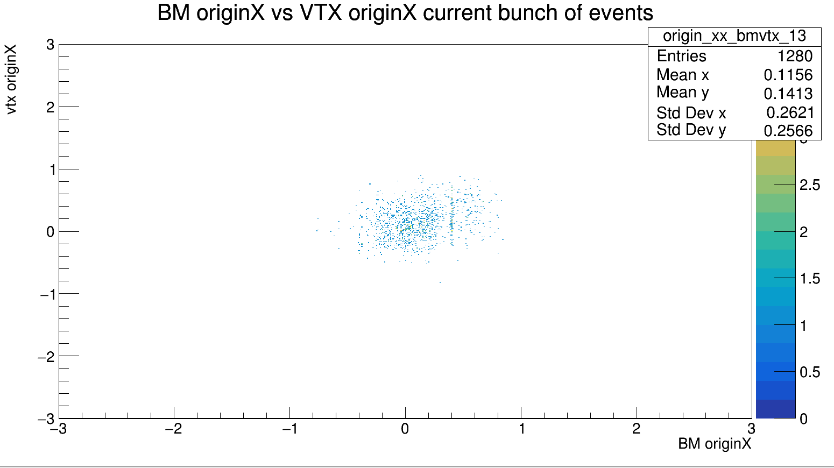
VT synch
correlazione tracce bm-vtx per eventi fino a 60 k
correlazione tracce bm-vtx per eventi da 60k a 65k
→ events up to 65000 are synchronized

Slide 6
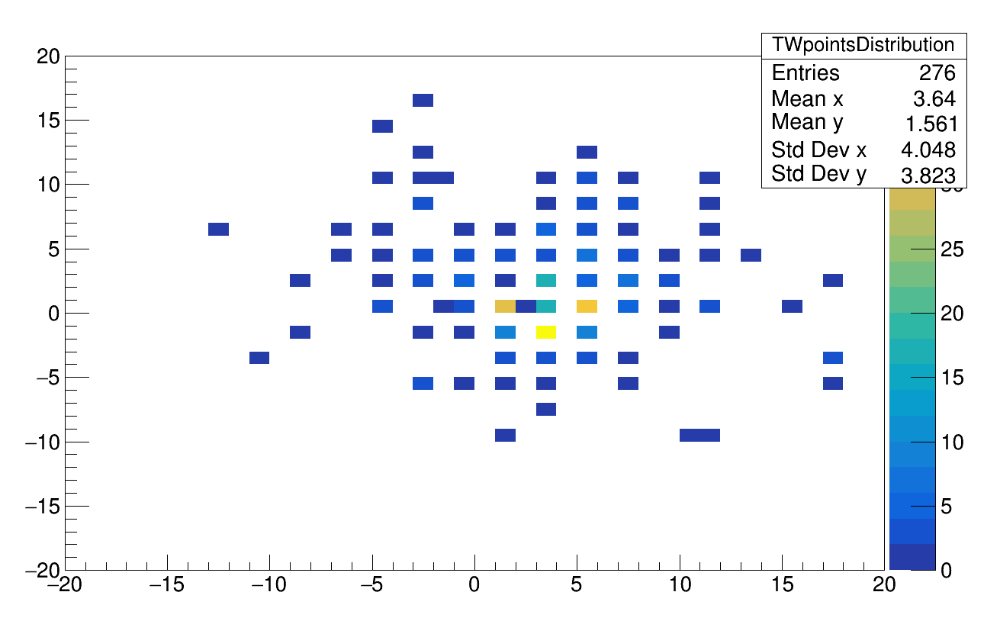
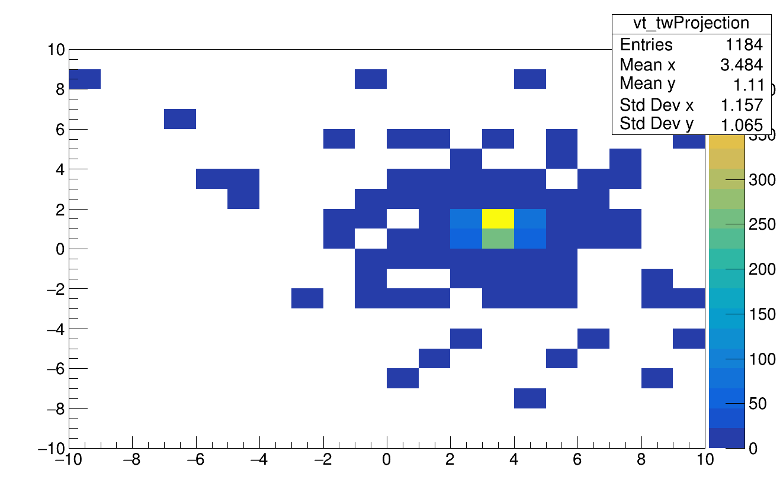
VT – TW allignment (fragments)
Projection of the tracklet in
the global frame
TW points (global frame)
→ TW is shifted wrt to VT

Slide 7
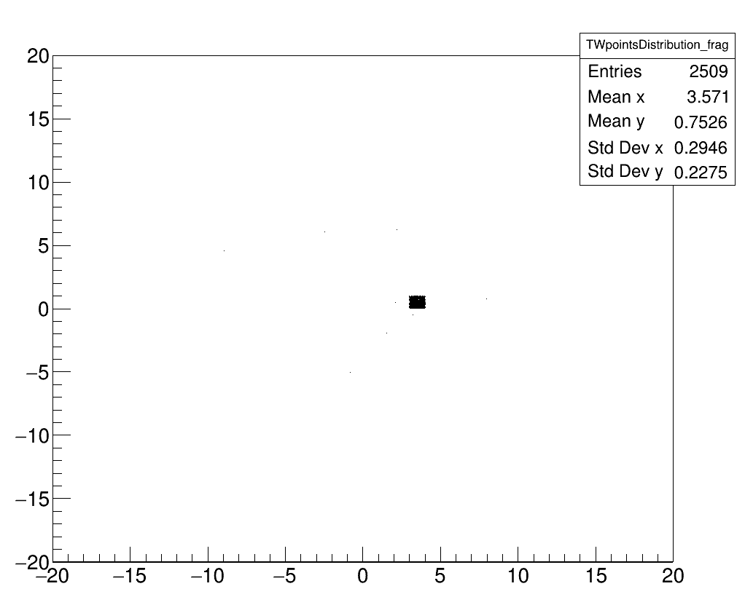
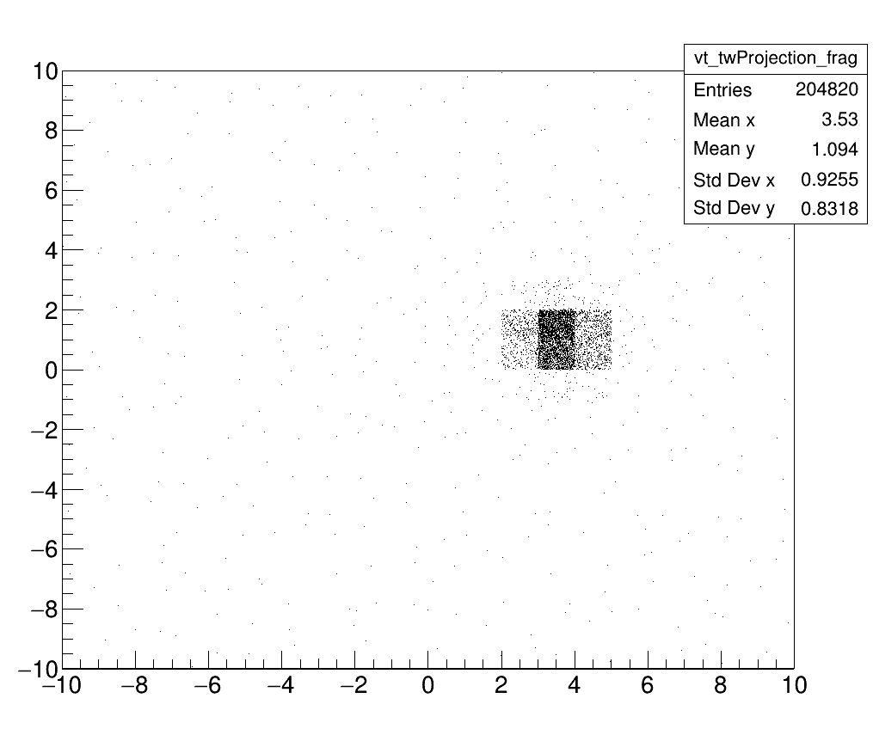
VT – TW allignment (beam)
TW points (global frame)
Projection of the tracklet in
the global frame
→ TW is shifted wrt to VT

Slide 8
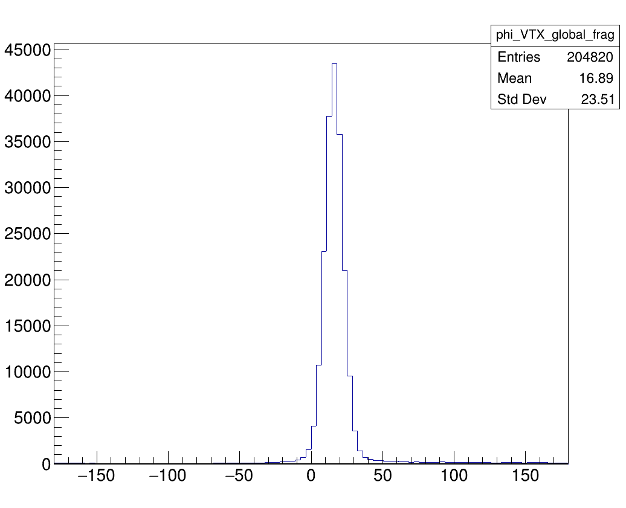
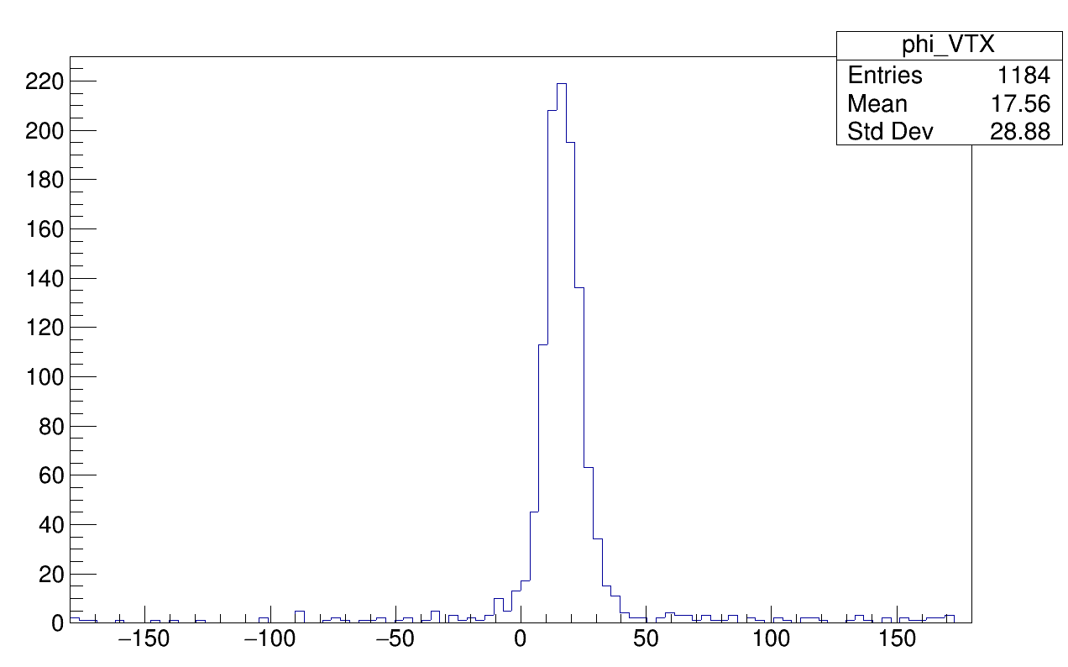
Tracklets Phi distribution
frags
oxygen
Azimutal distribution peaked around 18° → is the VT tilted?

Slide 9
Vectorial sum of all the tracklets of all events
Global frame:
fragment VT direction: theta = 1.123522 phi = 29.527197
beam VT direction: theta = 1.102172 phi = 25.031881
VT local frame:
fragment VT direction: theta = 0.361786 phi = 29.527197
beam VT direction: theta = 0.354997 phi = 25.031881
→ VT is rotated of ~1°
193 cm * tan(1°) ~ 4 cm → TW is shifted of 4 cm wrt to VT

Slide 11
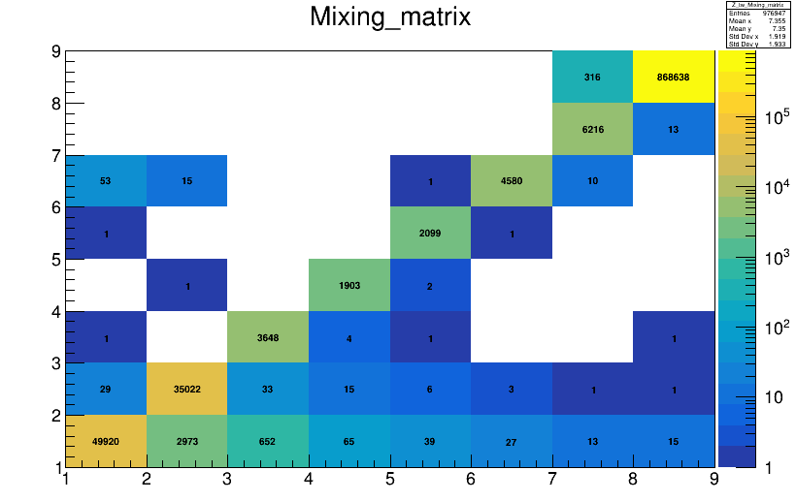
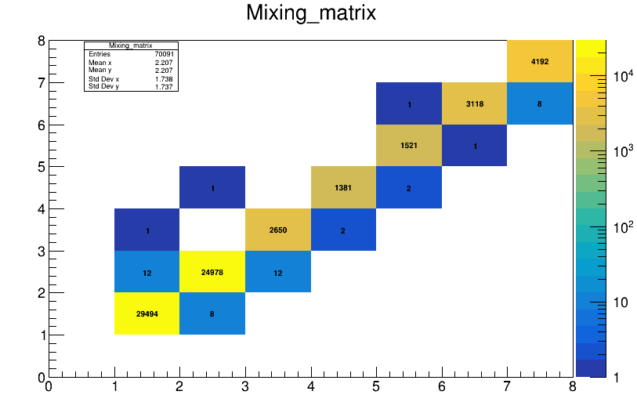
Migration Matrix studies – TW points
Z_{true}
Z_{true}
Z_{reco}
Z_{reco}
All TW points
TW points born in TG

Slide 12
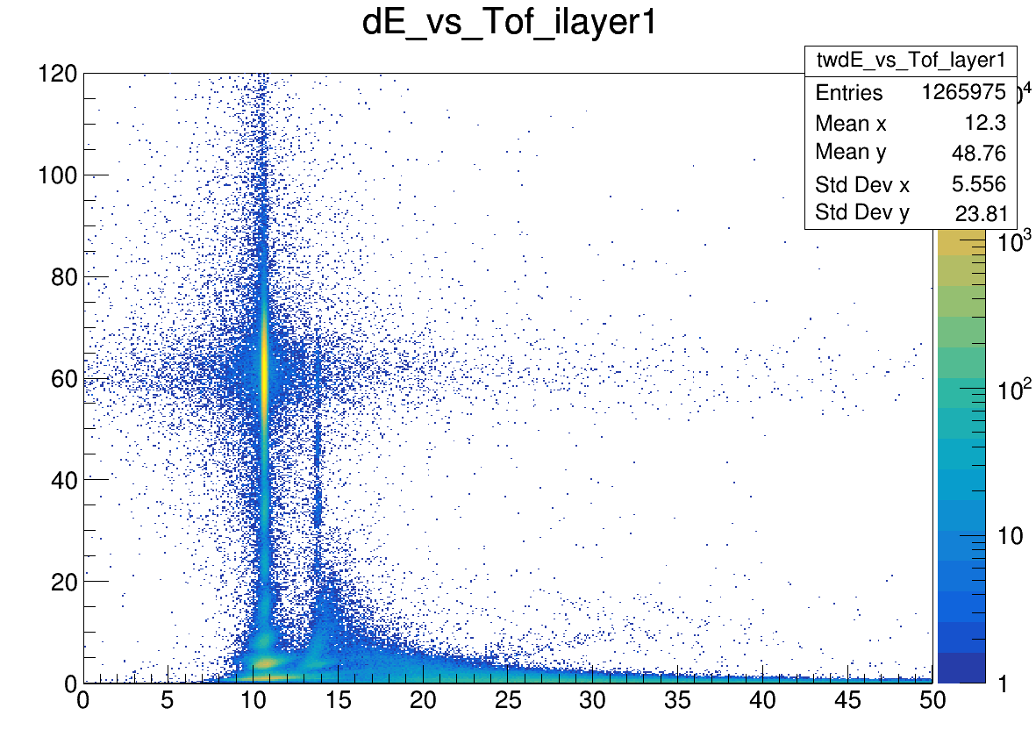
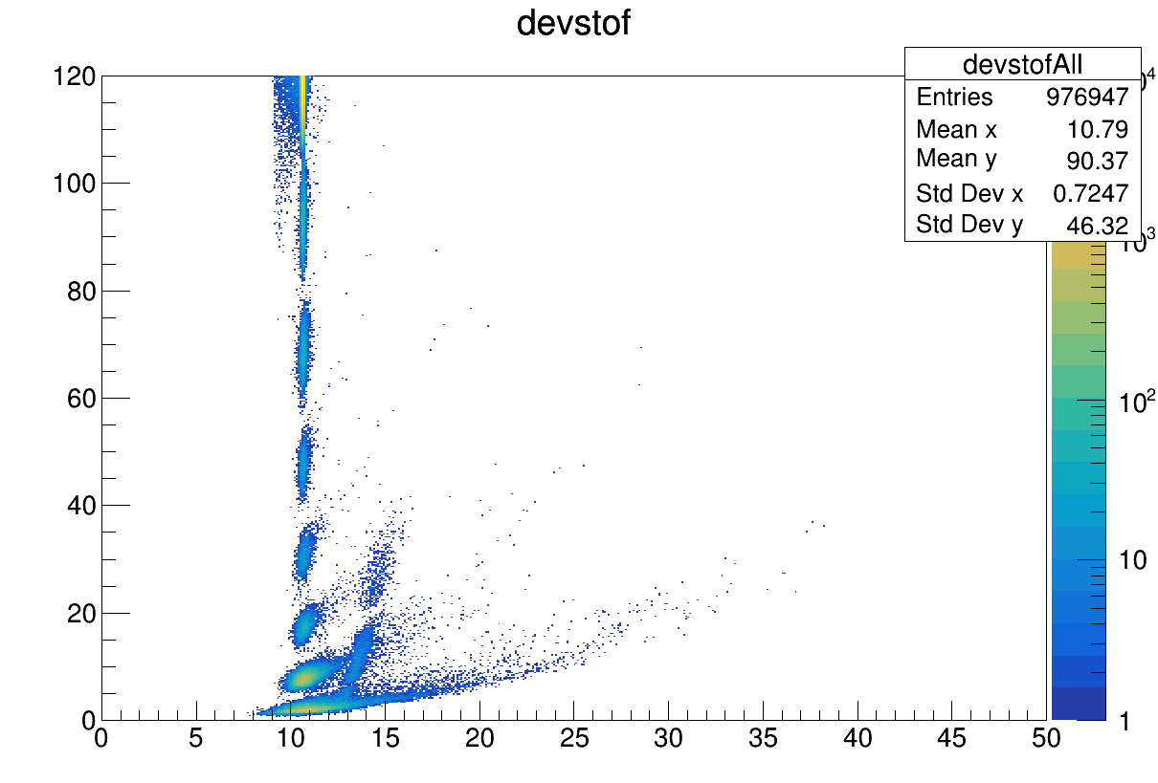
MC TW points
/gpfs_data/local/foot/Simulation/GSI2021_MC/16O_C_400_2_shoereg.root
ID > -1

Slide 13
Migration Matrix studies – TW ALL POINTS
Z_{true}
Z_{reco}
All TW points
Tail of H and He

Slide 14
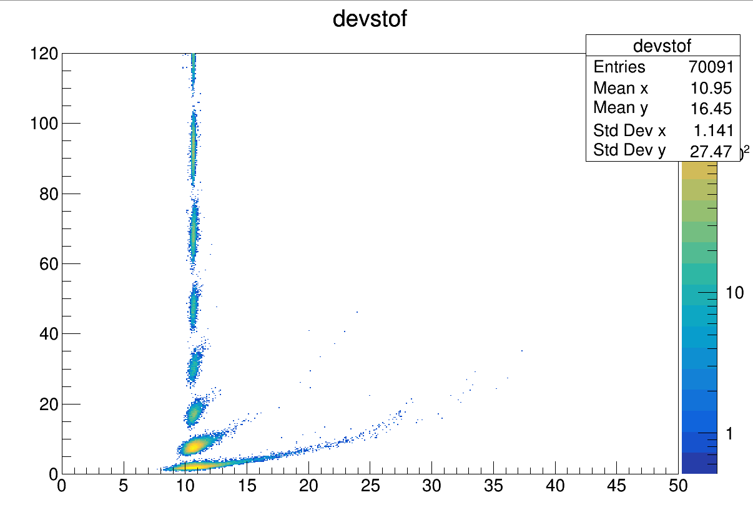
Migration Matrix studies – TW ONLY FRAGMENTS
Z_{true}
Z_{reco}
Fragments from target

Slide 15
Migration Matrix studies – TW ONLY FRAGMENTS
Z_{true}
Z_{reco}
Fragments from target

Slide 16
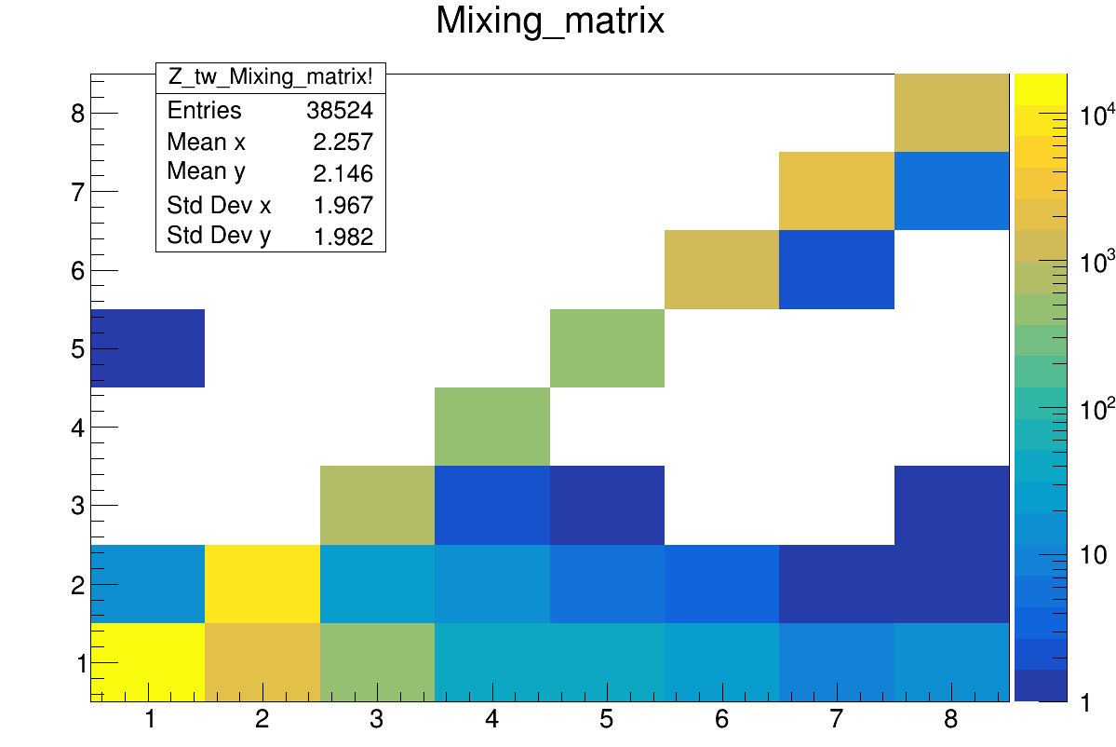
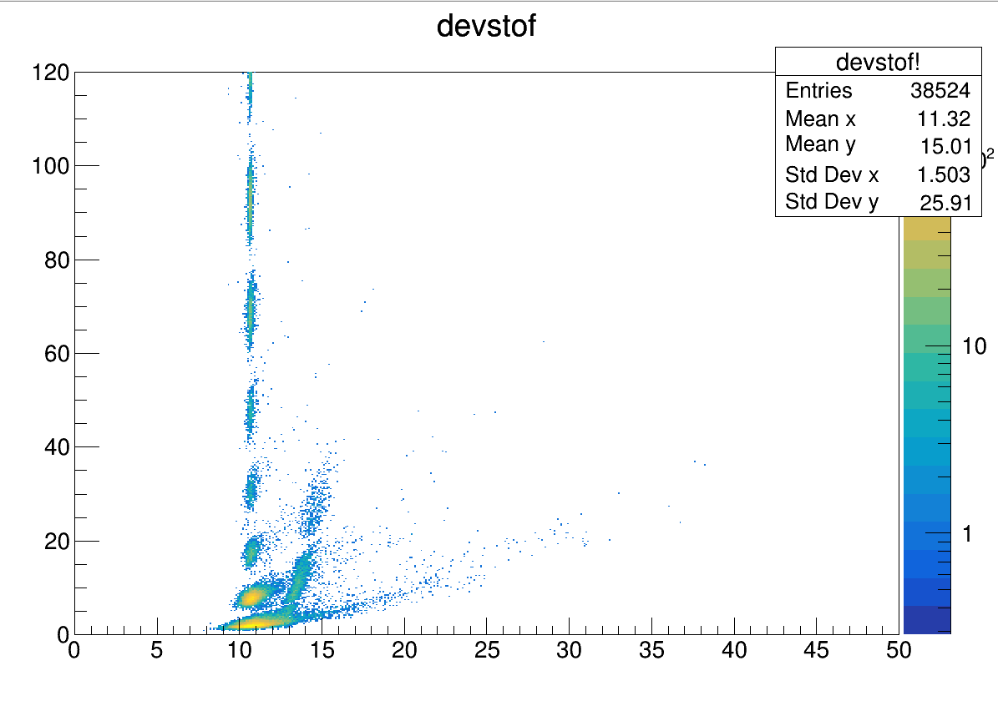
Migration Matrix studies – TW ONLY FRAGMENTS
Z_{true}
Z_{reco}
Secondary fragments

Slide 17
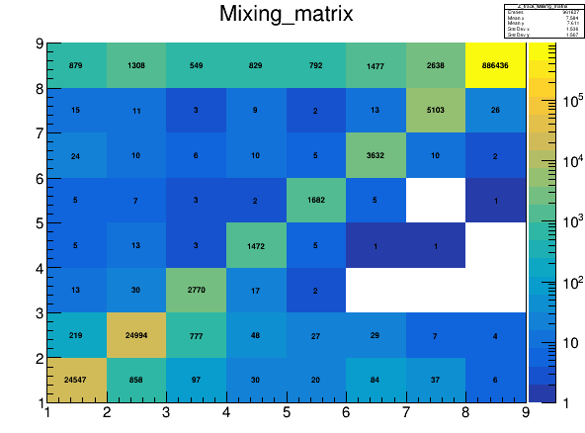
Migration Matrix studies – TW vs Global Tracking
Z_{true}
Z_{true}
All TW points
Z_{reco}
All reco tracks
Z_{reco}

Slide 18
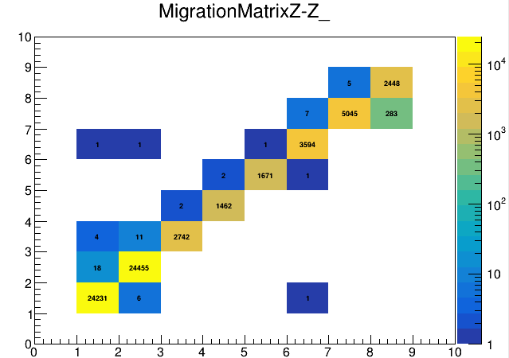
Migration Matrix studies – Global Tracking
Z_{true}
All reco tracks
Z_{reco}
Reco tracks after trigger simulation

Slide 19
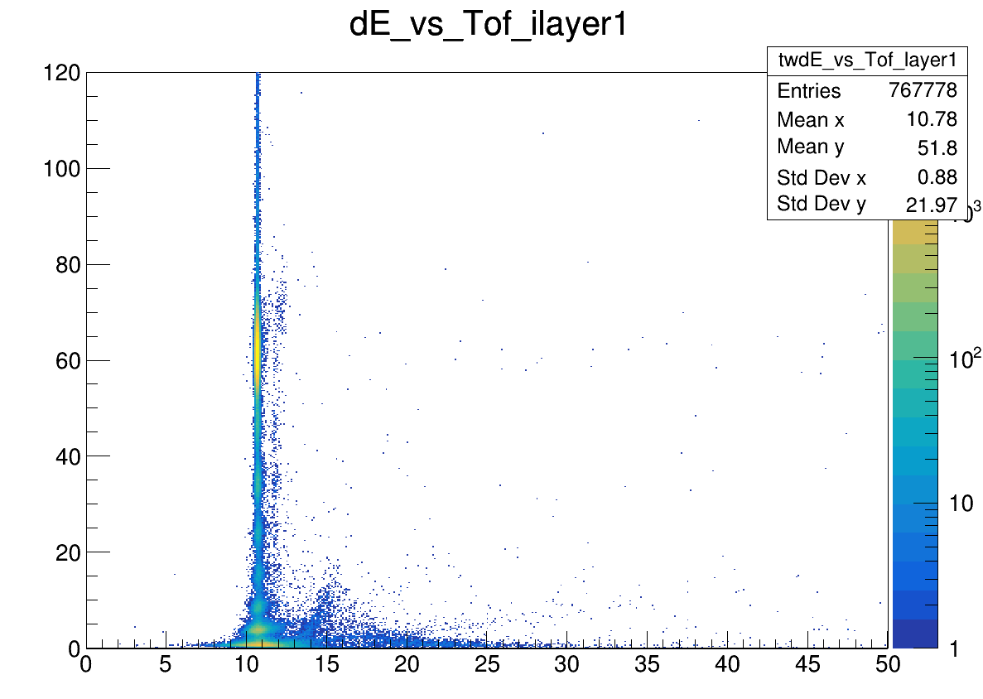
Run 4306
gpfs_data/local/foot/DataGSI2021/data_test.00004306.physics_foot.daq.RAW._lb0000._FOOT-RCD._0001.data

Slide 21
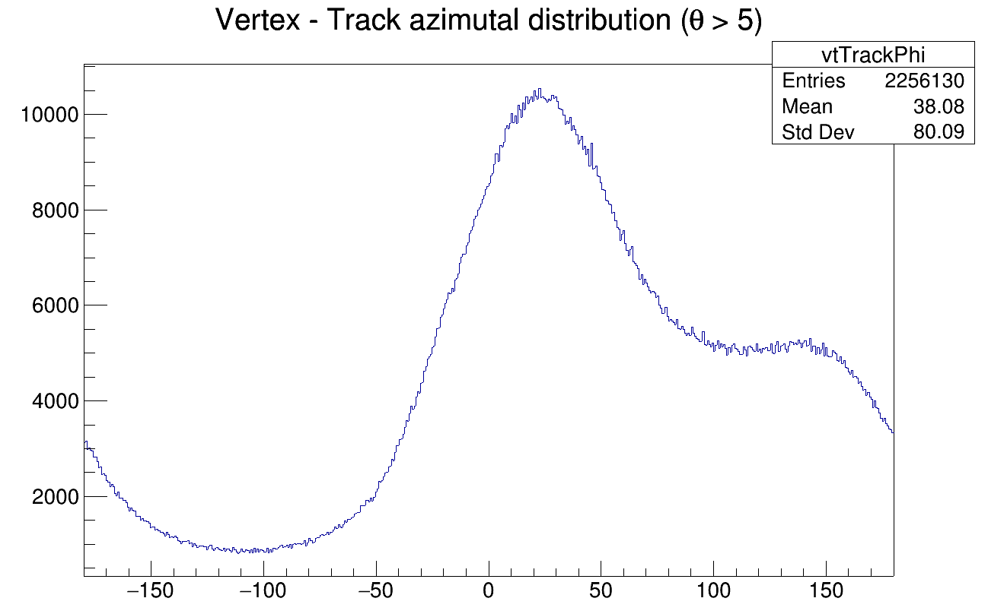
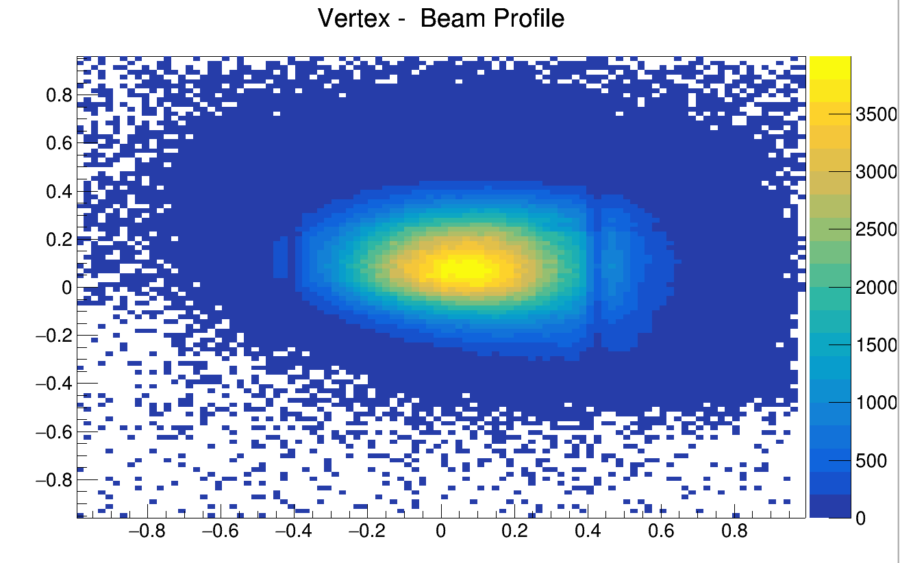
Phi distribution of ORIGIN of tracklets

Slide 22
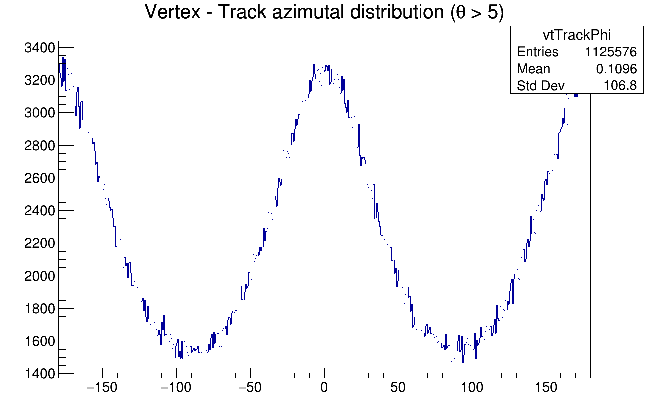
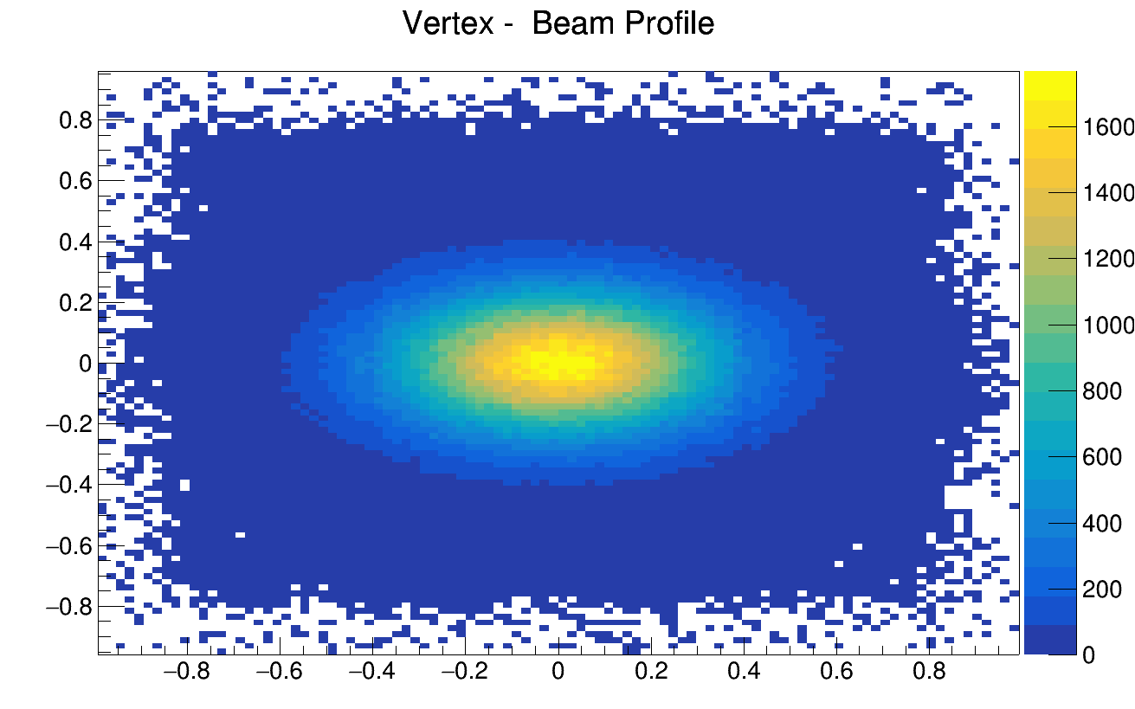
MC Phi distribution of ORIGIN of tracklets

Slide 23
